Slide 1
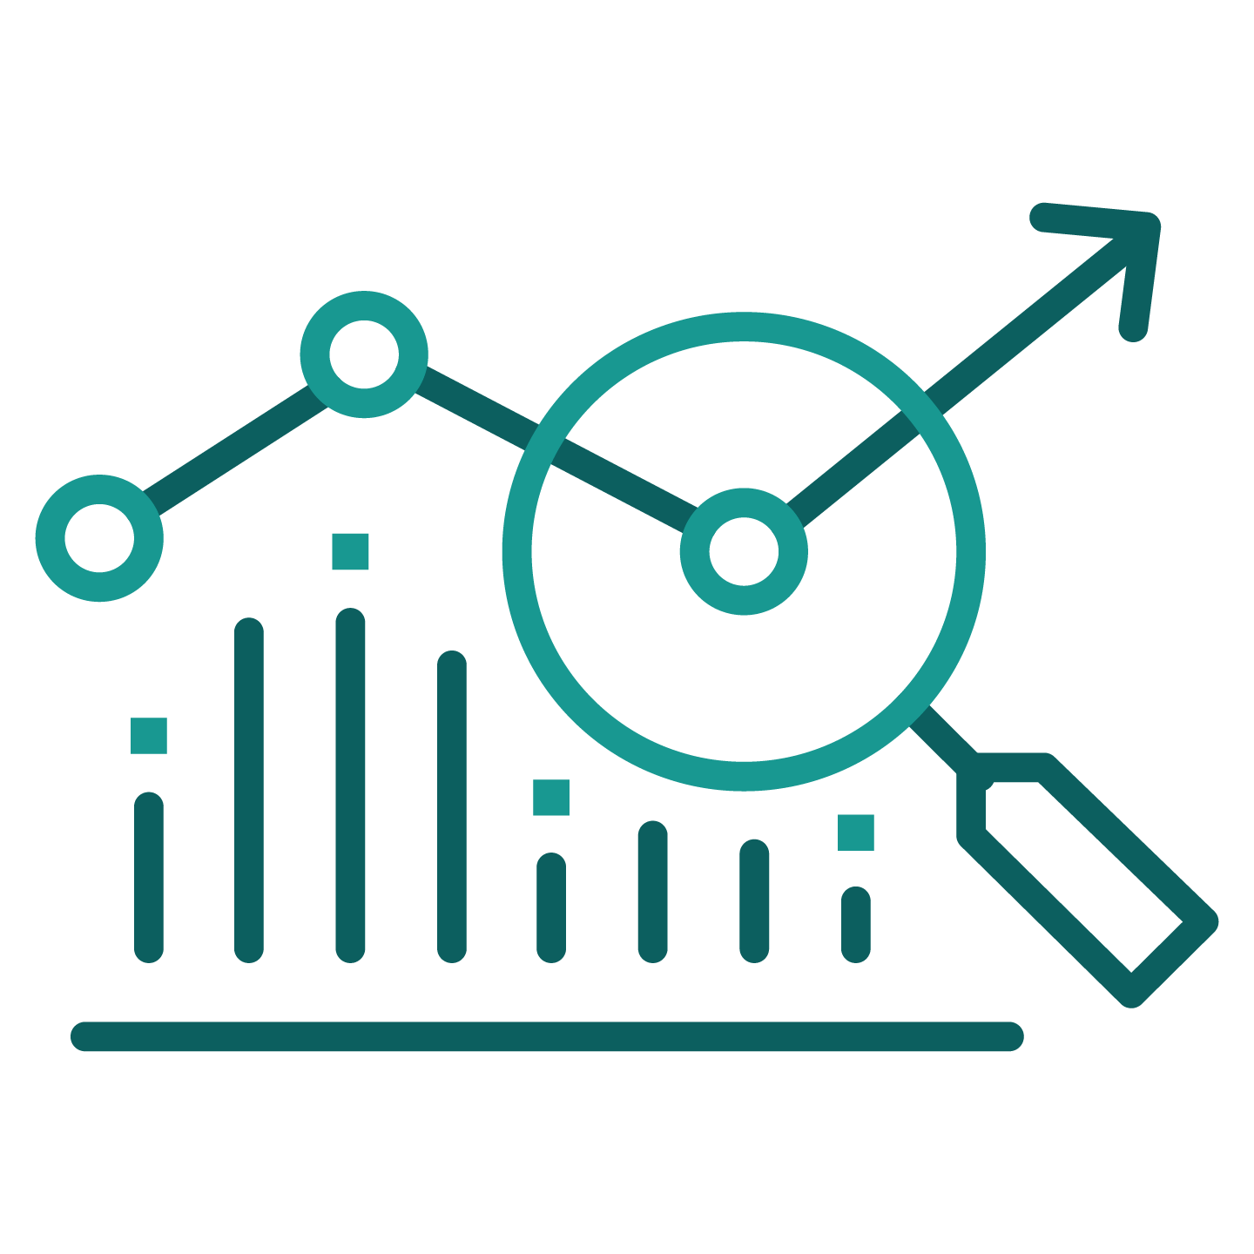
Vision for Rapid Transformation
All Digital Development Environment that Delivers Model Based Designs to a Smart Factory, Integrated Supply Chain, Sustainment Assets & Customers
All Digital Production Enterprise Derived from Engineering Models that Supports High Fidelity Factory and Build Simulations…Build Before You Build
Fully Integrated Advanced Manufacturing Capabilities Along with Human Augmentation
Preserves High Level of Systems Engineering Discipline & Maintains Strong Corporate Culture Around Product Safety
Model-Based Definition of Advanced Sustainment Architectures
Recognized World Class OneLM Software Factory
Common MBE Architectures Across BAs that Support Simulation Based Verification and High Degree of Collaboration Across Enterprise
Full Implementation of Digital Twin Capability through Integration of MBSE Artifacts, Design Models, Physics Based Simulations, and Manufacturing & Sustainment Data… Optimized by AI and Advanced Analytics
Adoption Metrics & Measures of Effectiveness to Confirm Value Creation
Speed to Market with Value Creating Capabilities is #1 Objective

