Slide 1
Nurture connection

Slide 2
Open space with a check in

Slide 3
5 mins
Wesley
Shannon
Nelson
How are you feeling about the project?
Change the colour of your circle to reflect
Kirsten
Jay
Notes:
Pre-populate names

Slide 4
5 mins
Wesley
Nelson
Shannon
How are you feeling about the project?
Change the colour of your circle to reflect
Kirsten
Jay
Notes:
Pre-populate names

Slide 5
What is your current energy level?
Write your name on a triangle and place it along the line
Jay :P
Kirst
Really tired
Super energetic

Slide 6
What’s on your mind today?
Cats! (Nope dogs are better)
Learning

Slide 7
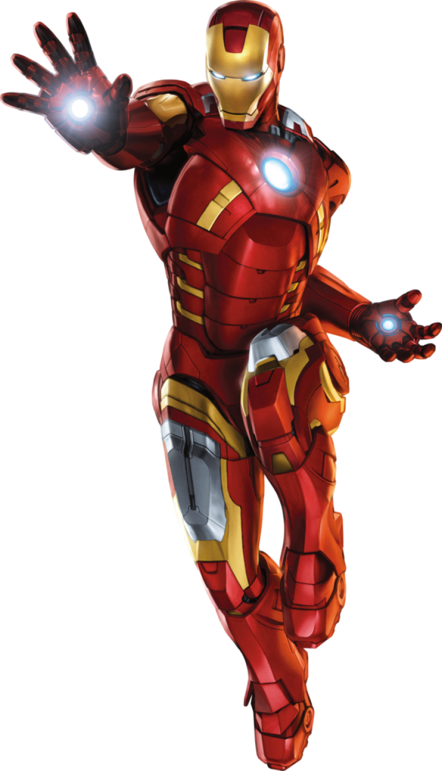
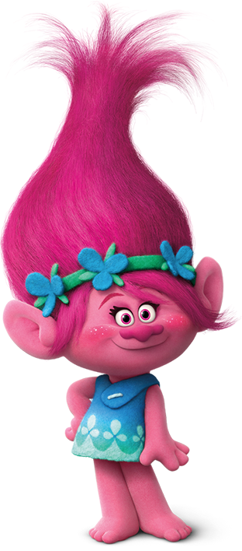
Everyone pastes a picture here of themselves or one that represents them outside the circle
The point is to learn about each other
So, one person starts by saying a statement… Ie. I love ice cream.
Everyone who loves ice cream drags their picture into the circle
We all return to outside the circle
Then someone else goes and this repeats on and on
example
Kirsten
Constellations

Slide 8
Socotra
Kirsten
Gratitude circle
Paste your name in a circle
Share an appreciation with the person next to you

Slide 9
What’s one of your favorite words in your home language?
Lekker
Dankie
sema
Awe

Slide 10
Work in smaller groups

Slide 11
We will divide into smaller groups to discuss the question: What are all the potential risks we can identify that might block us from meeting this deadline?
Click on a link below to join a room.
BREAKOUT ROOM 1
BREAKOUT ROOM 2
BREAKOUT ROOM 3

Slide 12
Attention to differing contexts

Slide 13
UTC-6
UTC-3
UTC+1
UTC+5
UTC+8
UTC+9
8:00 am
11:00 am
3:00 pm
7:30 pm
10:00 pm
11:00 pm
Copy a picture of yourself in here
Copy a picture of yourself in here
Copy a picture of yourself in here
Copy a picture of yourself in here
Copy a picture of yourself in here
Copy a picture of yourself in here
Name & Role
Name & Role
Name & Role
Name & Role
Name & Role
Name & Role
Copy a picture of yourself in here
Copy a picture of yourself in here
Copy a picture of yourself in here
Copy a picture of yourself in here
Copy a picture of yourself in here
Copy a picture of yourself in here
Name & Role
Name & Role
Name & Role
Name & Role
Name & Role
Name & Role
Copy a picture of yourself in here
Copy a picture of yourself in here
Copy a picture of yourself in here
Copy a picture of yourself in here
Copy a picture of yourself in here
Copy a picture of yourself in here
Name & Role
Name & Role
Name & Role
Name & Role
Name & Role
Name & Role

Slide 14
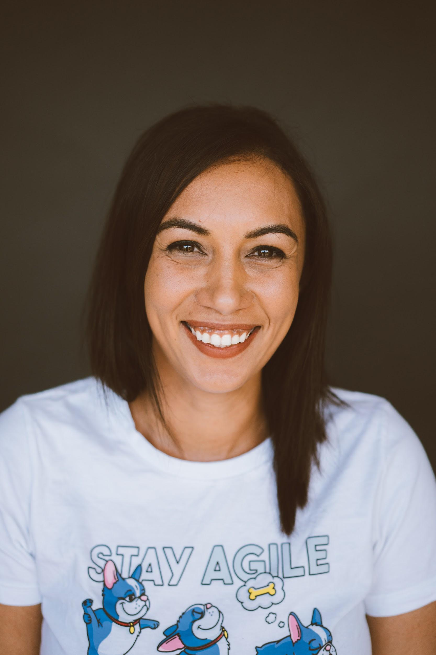
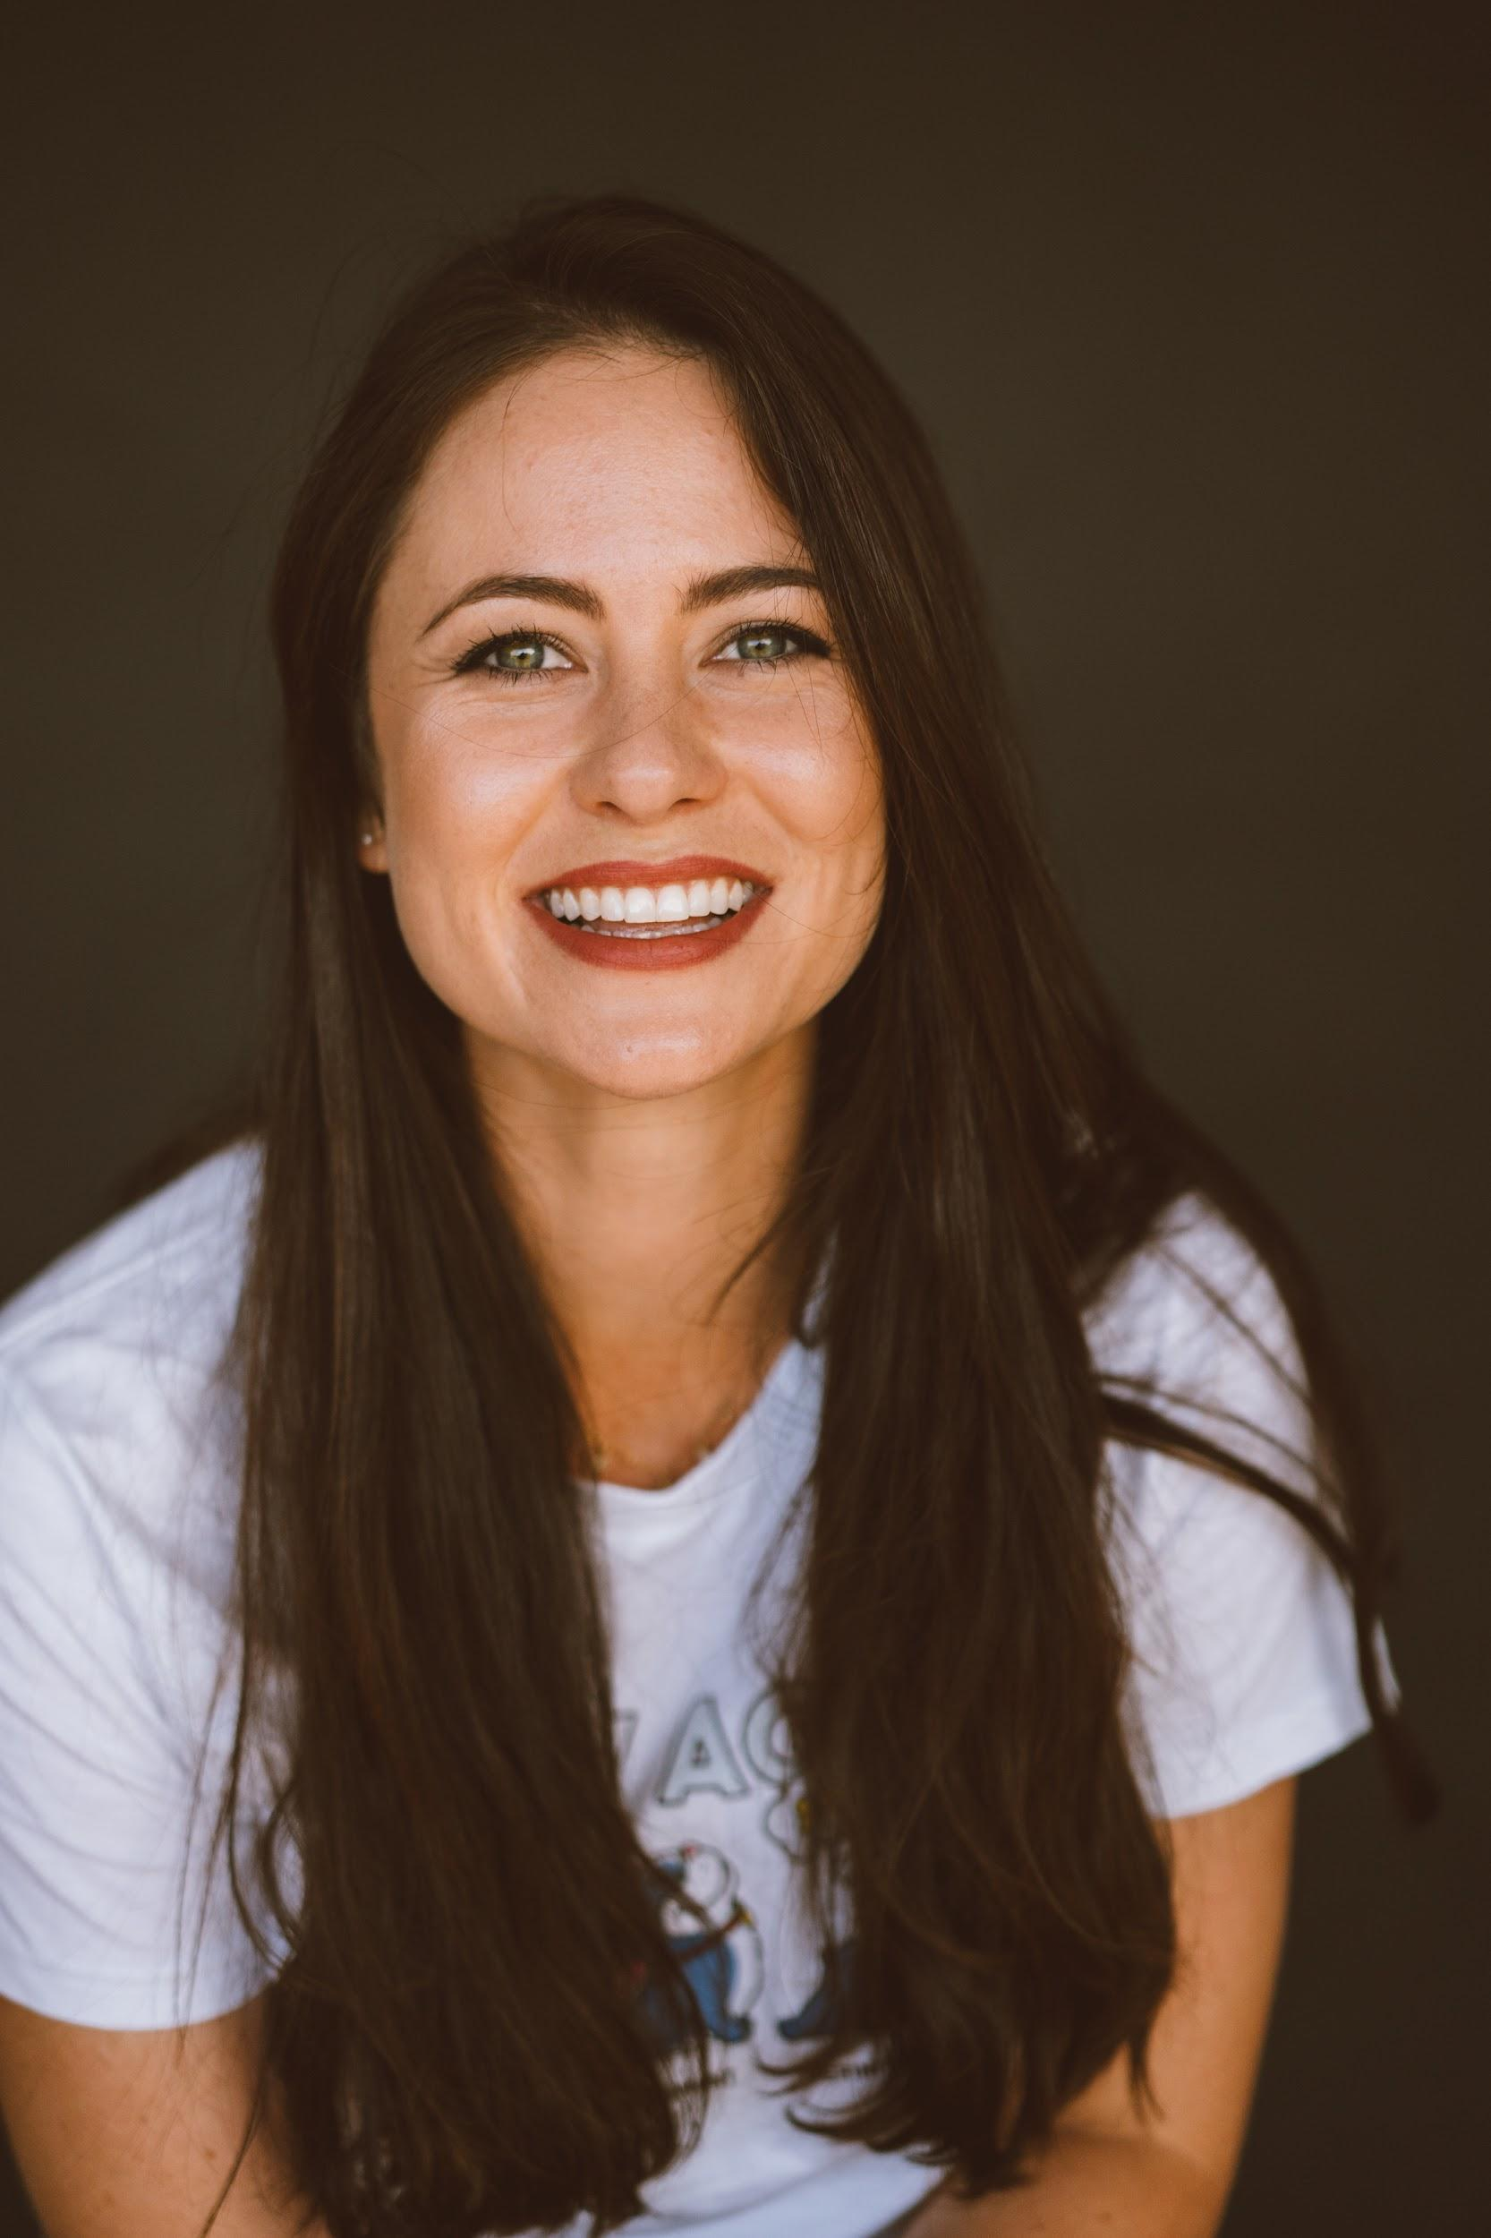
UTC-6
UTC-3
UTC+1
UTC+5
UTC+8
UTC+9
8:00 am
11:00 am
3:00 pm
7:30 pm
10:00 pm
11:00 pm
Copy a picture of yourself in here
Copy a picture of yourself in here
Copy a picture of yourself in here
Copy a picture of yourself in here
Copy a picture of yourself in here
Copy a picture of yourself in here
Name & Role
Name & Role
Jay
Team Coach
Name & Role
Name & Role
Name & Role
Copy a picture of yourself in here
Copy a picture of yourself in here
Copy a picture of yourself in here
Copy a picture of yourself in here
Copy a picture of yourself in here
Copy a picture of yourself in here
Name & Role
Kirsten Team Coach
Name & Role
Name & Role
Kirsten Team Coach
Jay Team Coach
Copy a picture of yourself in here
Copy a picture of yourself in here
Copy a picture of yourself in here
Copy a picture of yourself in here
Copy a picture of yourself in here
Copy a picture of yourself in here
Name & Role
Name & Role
Name & Role
Name & Role
Name & Role
Name & Role

Slide 15
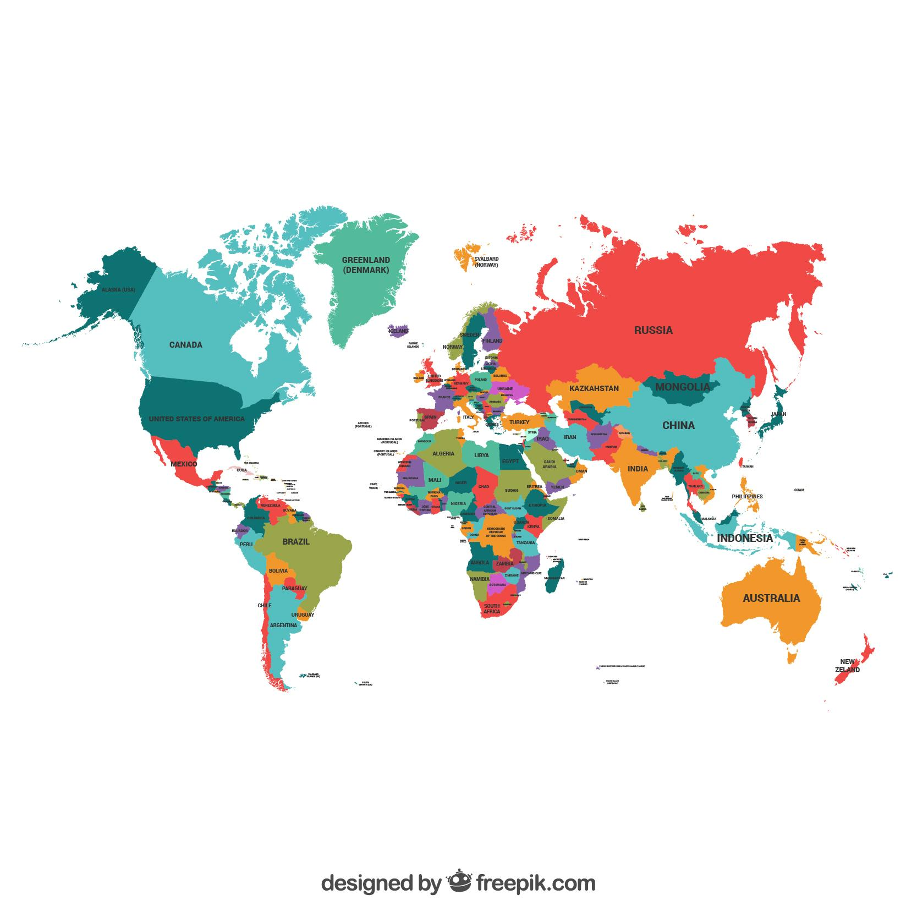
Where in the world are you?
Pick a pin on your right and pop it on the map where you currently live.
Notes:
<a href="https://www.freepik.com/free-photos-vectors/travel">Travel vector created by freepik - www.freepik.com</a>
Icons made by <a href="https://www.flaticon.com/authors/freepik" title="Freepik">Freepik</a> from <a href="https://www.flaticon.com/" title="Flaticon"> www.flaticon.com</a>

Slide 16
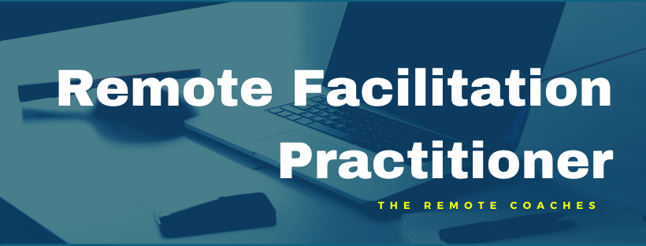
Want to learn more?
info@theremotecoaches.com
@RemoteBetter
Available on Amazon
The Remote Facilitation Practitioner
(Interactive online course)
Remote Facilitation Video Course
(Self study video course)
@RemoteBetter
Notes:
Jay

