Slide 1
Post Session Hand OUT
Assessing Your Agile Coaching Competency.

Slide 2
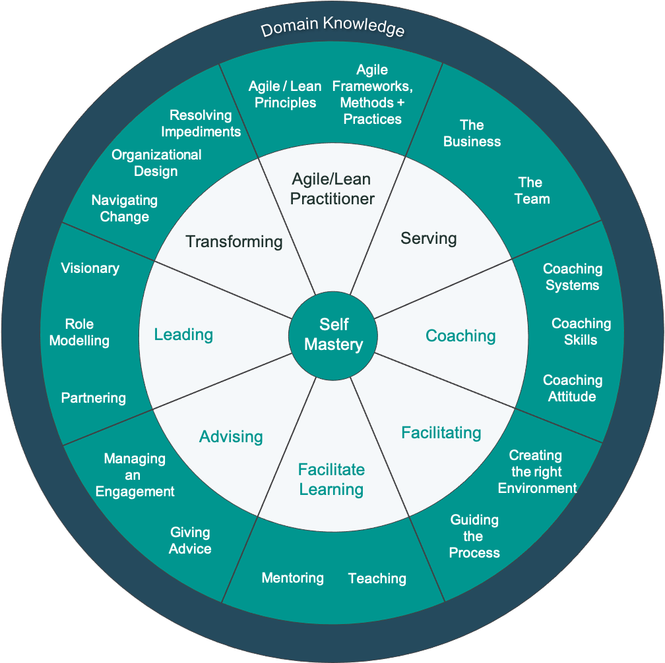
The Evolution- A Path To Scrum Alliance Coach
The Competencies
Agile/ Lean Practitioner
Serving
Coaching
Facilitating
Facilitate Learning
Advising
Leading
Transforming
Self Mastery

Slide 3
The Competencies
Active Competencies
Neutral Competencies
Agile/Lean Practitioner:
Ability to work with and deeply understand Agile / Lean frameworks principles and practices.
Transforming:
Planning for and guiding an organization in its Agile/Lean adoption. Helping and nurturing people in the Agile journey.
Leading:
A visionary for role modelling leadership skills we want to see in all and partnering in a spirit of shared responsibility
Advising:
As an advisor or consultant with an individual, team or within the wider organization you are responsible for setting the workup for success and may also be called on to play the role of a trusted advisor.
Serving:
A servant-leader focuses primarily on the growth and well-being of people and the communities to which they belong.
Coaching:
Coaching is unlocking a person’s potential to maximize their own performance. It is helping them to learn rather than teaching them.
Facilitating:
Facilitation is the practical neutral craft of creating environments of openness, safety and innovation.
Facilitate Learning:
Agile is all about learning, as an Agile Coach, you will need to facilitate the learning of other people around you, helping them learn new skills and knowledge.
The Core
Self Mastery:
For one to be successful in giving out, one first needs to establish a strong self. This is described as Knowing Yourself, Being and Self Care

Slide 4
How Do You Measure Progress?
Dreyfus Model
Beginner
Knows the theory with only limited real practical experience.
Advanced Beginner
Experience in the Application with individual teams and exposure to organizational coaching.
Practitioner
Demonstrates a working knowledge of all aspects of the Agile Coaching Growth Wheel and can apply in most situations independently.
Guide
Unconscious competence has mastered the application and knows when to bend and when to break the rules.
Trailblazer
Capability to change to meet the current situation and innovate to create new techniques.
Of Skill Acquisition
A model describing how learners acquire skills through formal instruction and practice.
Mastery can’t be achieved only with books
Note: Dreyfus is compatible with Bloom’s Taxonomy
Notes:
The Dreyfus model of skill acquisition is a model of how learners acquire skills through formal instruction and practice, used in the fields of education and operations research. Brothers Stuart and Hubert Dreyfus proposed the model in 1980 in an 18-page report on their research at the University of California, Berkeley, Operations Research Center for the United States Air Force Office of Scientific Research.[1] The model proposes that a student passes through five distinct stages: novice, advanced beginner, competent, proficient,and expert.

Slide 5
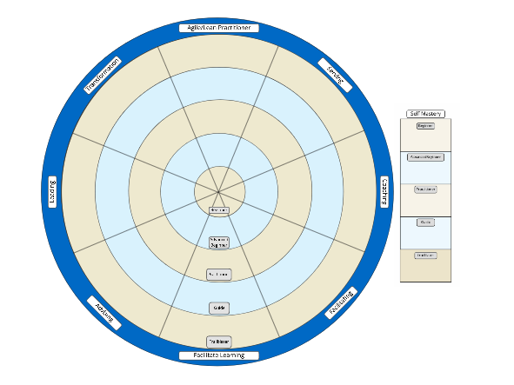
Assess Yourself
You can also download a Miro backup file with this exercise template. This will allow you to do a collaborative exercise with colleagues or coworkers.
Download the Miro backup from the same location you downloaded this handout.

Slide 6
Let the Journey Begin!
Resource Library
https://resources.scrumalliance.org
Find A Course Today
https://www.scrumalliance.org/
courses-events/search

Slide 7
