Slide 1
Bridging the Gap Between Finance, Execution, and Customer Value
Phil Alfano
Konstantin Popov
Rochelle Tan

Slide 2
Scaling agile across the enterprise
The move to agile at scale is on the rise to achieve business agility and keep pace with the speed of innovation.
80
%
By 2023
48% percent of business & technology decision makers have shifted to continuous portfolio planning to innovate faster.
40% of large enterprise IT organizations will complete implementation of product-centric approaches this year.
By 2023, 65% of organizations will have embedded digital product managers in a business area.
of organizations will have an enterprise PMO focused on integrating digital products and programs
Notes:
Businesses are shifting from waterfall to agile or adopting hybrid to:
Faster time to market
Increased productivity
Improvements in quality
They want to keep up with the needs of the business to delivers the right products to their customers faster than their competition.
Ultimately, organizations want to deliver more value to customers through business agility and product innovation.

Slide 3
Alignment across technology and finance organizations
Business objectives
What outcomes does technology provide?
Innovation
Competitive differentiation
Digital agility
Operational & financial efficiency
CEO, BoD
Development tactics
How do you build & run it?
Shift from waterfall to agile
Plan & track value
Align goals to work
PMO
Financial management
How do you fund it?
Analyze, optimize & plan cloud and hybrid
Drive accountability
Benchmark against peers
IT Finance
Notes:
These new ways of working involve new dynamics, but difficult for most organizations because work management and financial management systems are discrete, disconnected systems. Work is being performed on an ongoing basis oftentimes with scope, timing, or budget changes that are not reflected in the financial plan. The consequences are twofold: a) chronically going overbudget on new project and product investments and b) an inability to track or highlight the business value and/or ROI (inclusive of *both* operational and financial value) of these projects.
When we’ve talked to analysts, they’ve said that a single source of truth across value streams – and across the business, IT and Finance -- is what breaks down these silos.
To understand the ROI of investments and ultimately increase operational efficiency and efficacy across their business will require alignment across all levels. This spans from high-level business objectives, to the strategy (i.e., the what and why) that supports those objectives, to the tactics (i.e., the how and who). To execute those plans, you need a solution that allows you to ANALYZE the operational delivery in real time, so that you can ACT, ADJUST, and GOVERN to drive better business outcomes.

Slide 4
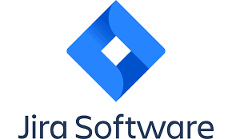
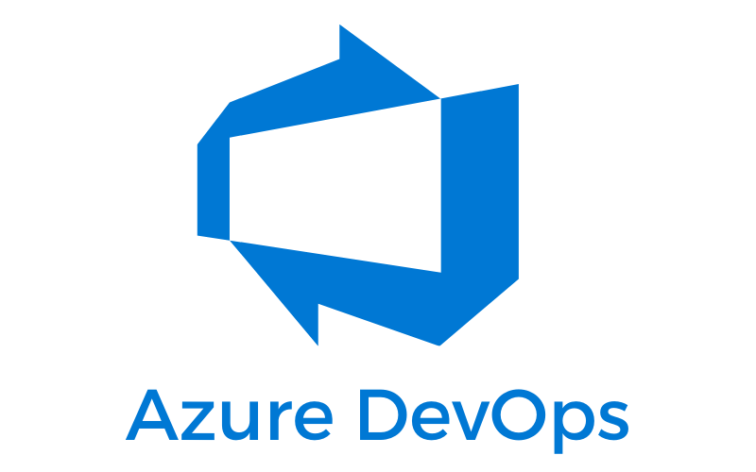
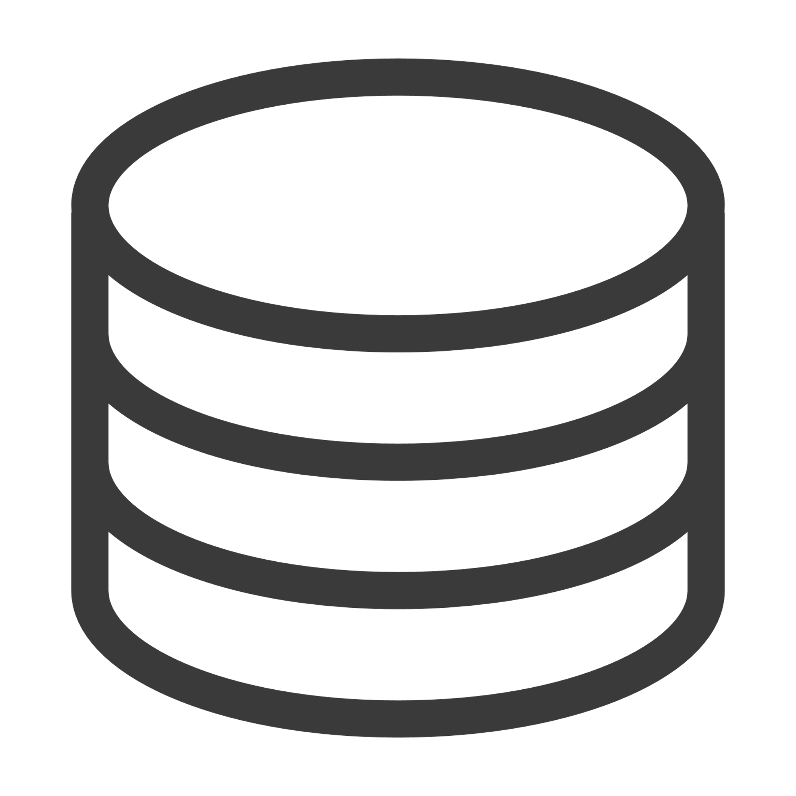
Bridging the gap between finance and execution
Plan
Work Management
Technology Finances
Build a comprehensive operational and financial plan
DAILY/HOURLY
MONTHLY
Analyze
=
Understand changes across portfolio & make resource adjustments
Project plans
Team /individual work
Public Cloud
On-premises
Act
Backlog
Labor capacity
Maintenance
Labor
Adjust investments and priorities based on budget and ROI
Notes:
Apptio Targetprocess solves this through its integration with ApptioOne and Cloudability to provide an unmatched work management and financial planning solution.
Specifically,
Users of ApptioOne are planning, forecasting, and analyzing their technology budget and spend at a granular level across various dimensions including hybrid infrastructure (public/private cloud and data centers), technology maintenance “run” costs, and labor rates.
Users of Targetprocess are managing work execution and labor capacity at the project, team, and individual level via deep integrations with Azure DevOps and Jira.
Across both products, users are able to manage, plan, and analyze the work and financial impact of their technology portfolio at the project, product, and program level.
As a result, we bring together stakeholders and information across business, finance, and operations to ensure that finances are considered alongside each other at every stage of the development lifecycle—from PLANNING (e.g., How do I establish an appropriate budget? How do I fund that budget?), to ANALYZING (e.g., how do I understand fully-burdened costs across labor and non-labor and how to those compare to my budget? How do I measure ROI of this product?), to ADJUSTING or ACTING (e.g., how can I adjust the technology portfolio across this project to reduce costs?)
[NEXT SLIDE]

Slide 5
Delivering better value through enterprise agility
Align Work & Strategy
Idea Creation
Technology
Finance
Fund Work
Execute & Measure
Analyze & Act
Notes:
Here’s how it works:
Our integration allows an organization to start with an idea-generation (captured in the form of strategic initiatives), follow that idea as it continues to grow and expand into features or capabilities and ultimately roll those features into a project, inclusive of estimated headcount and costs.
At this point, leadership is able to evaluate all projects coming from Targetprocess and their relative estimated cost to help inform their technology budget for the year. They are able to make strategic decisions in real-time with readily available data from strategy down to technical execution.
As they decide what projects to fund they are able to publish the associated project budgets to Targetprocess, where they can continue key portfolio management activities including, but not limited to, planning resource capacity, what-if analysis and prioritization, and monitoring project progress.
At some point in the delivery process, conversations with the business happen. These conversations can take form of headcount adjustments, requests for increase in funding, or budget variance analysis exercises. This visibility and breadth of data allows leadership to quickly and precisely understand overall health of their project portfolio and specifically, arrive at a project TCO.
This cycle can then be run at any frequency the organization so chooses, whether that be annually, quarterly, or monthly.

Slide 6
Delivering better value through enterprise agility
Strategy
Notes:
Here’s how it works:
Our integration allows an organization to start with an idea-generation (captured in the form of strategic initiatives), follow that idea as it continues to grow and expand into features or capabilities and ultimately roll those features into a project, inclusive of estimated headcount and costs.
At this point, leadership is able to evaluate all projects coming from Targetprocess and their relative estimated cost to help inform their technology budget for the year. They are able to make strategic decisions in real-time with readily available data from strategy down to technical execution.
As they decide what projects to fund they are able to publish the associated project budgets to Targetprocess, where they can continue key portfolio management activities including, but not limited to, planning resource capacity, what-if analysis and prioritization, and monitoring project progress.
At some point in the delivery process, conversations with the business happen. These conversations can take form of headcount adjustments, requests for increase in funding, or budget variance analysis exercises. This visibility and breadth of data allows leadership to quickly and precisely understand overall health of their project portfolio and specifically, arrive at a project TCO.
This cycle can then be run at any frequency the organization so chooses, whether that be annually, quarterly, or monthly.
[NEXT SLIDE]
***
(this version reflects Andrey’s edits and uses the term ‘Project’ to keep ideas simple and clean through this example. Organizations can interchange their funding vehicle of choice – such as investment, capacity, value stream – while using the same foundational integration.)

Slide 7
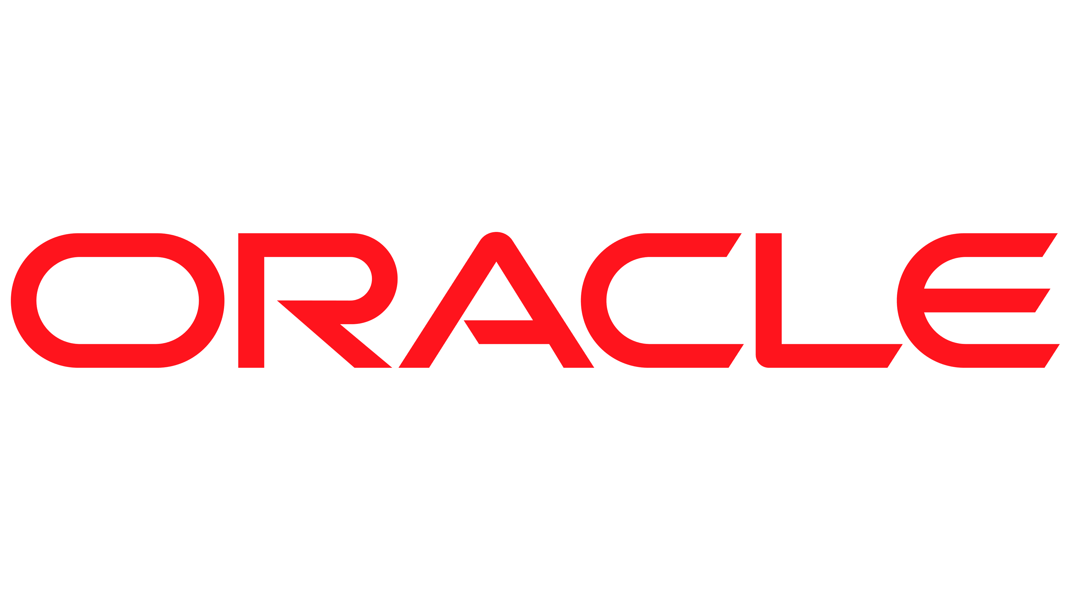
How ApptioOne + Targetprocess integration works
ApptioOne
Idea creation
Targetprocess
Strategic initiatives
EXEC
Align Work & Strategy
Fund Work
Execute & Measure
Analyze & Act
Align Value Streams to strategy
Request more non-labor funding
Manage feature roadmaps & delivery
CIO & Business value dashboards
Allocate/plan resource capacity
Reconcile line-item expenses
Manage risks and dependencies
ROI & margin analysis
Plan & prioritize work
Request more labor
Measure progress against OKRs
Budget vs actuals reporting
What-if analysis of prioritizing work
Adjust project funding
Capture value delivered
BU consumption analytics
IT Finance/PMO/PM/RTE
Send budget for strategic projects & products
Technology budget & actuals
Labor & non-labor expenses
Act on future planning cycles
IT Finance
Notes:
Here’s how it works:
Our integration allows an organization to start with an idea-generation (captured in the form of strategic initiatives), follow that idea as it continues to grow and expand into features or capabilities and ultimately roll those features into a project, inclusive of estimated headcount and costs.
At this point, leadership is able to evaluate all projects coming from Targetprocess and their relative estimated cost to help inform their technology budget for the year. They are able to make strategic decisions in real-time with readily available data from strategy down to technical execution.
As they decide what projects to fund they are able to publish the associated project budgets to Targetprocess, where they can continue key portfolio management activities including, but not limited to, planning resource capacity, what-if analysis and prioritization, and monitoring project progress.
At some point in the delivery process, conversations with the business happen. These conversations can take form of headcount adjustments, requests for increase in funding, or budget variance analysis exercises. This visibility and breadth of data allows leadership to quickly and precisely understand overall health of their project portfolio and specifically, arrive at a project TCO.
This cycle can then be run at any frequency the organization so chooses, whether that be annually, quarterly, or monthly.
[NEXT SLIDE]
***
(this version reflects Andrey’s edits and uses the term ‘Project’ to keep ideas simple and clean through this example. Organizations can interchange their funding vehicle of choice – such as investment, capacity, value stream – while using the same foundational integration.)

Slide 8
Panel Discussion
Phil Alfano
Konstantin Popov
Rochelle Tan
CTO of Field Sales
TITLE
TITLE
Apptio
Vincerion
Chevron

Slide 9
Thank you!

