Slide 1
Jonny Philip
When a developer read the Scrum Guide
🎵What is Scrum? Baby don’t hurt me…🎵

Slide 2
Why talk about Scrum?

Slide 3
Who am I?
Originally from Scotland
Recently returned to Europe after 8 years in Australia
Full-stack developer

Slide 4
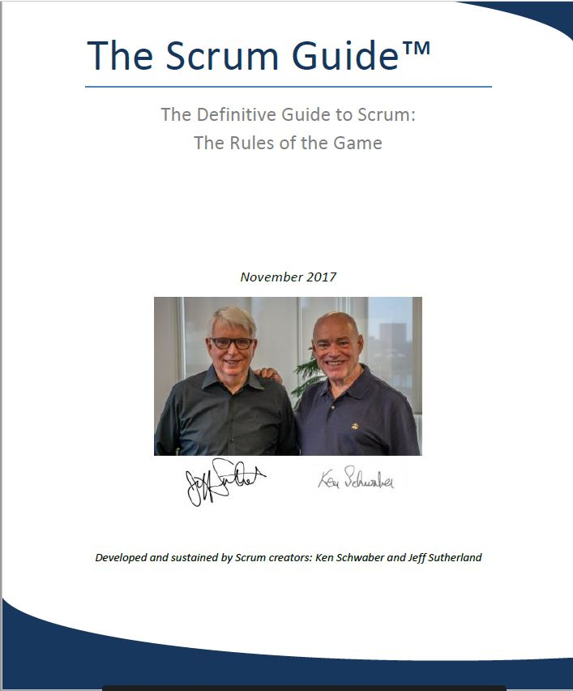
My Scrum Experience

Slide 5
Why did I read the Scrum Guide?

Slide 6
Surprises!

Slide 7
Surprise 1
It’s short!

Slide 8
Surprise 2
There are a lot of versions, sometimes with contradictory changes!
When do you choose a Sprint Goal?

Slide 9
Surprise 3
Scrum is immutable!

Slide 10
Surprise 4
The 3 Questions” are dead!
We are re-focused instead solely on the Sprint Goal

Slide 11
Surprise 5
The Sprint Backlog can change!
Was this another contradiction with earlier versions of the Guide?
Is it worthwhile to figure out “precisely” how much to take into the Sprint during Planning?

Slide 12
Surprise 6
What was not in it!
Where are all those things that people say about Scrum or that you should do in Scrum?
The SM needs to protect the team from the PO (!)
That something bad has happened if all the items in the Sprint Backlog were not completed
You need to estimate items

Slide 13
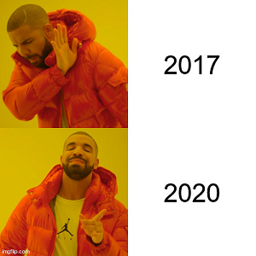
Different versions of the Guide
We are uncovering better ways of working
How many different ways are Scrum teams really working?
Is Scrum really a generally applicable framework?

Slide 14
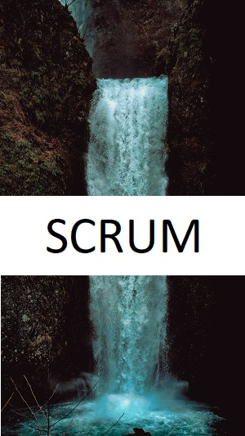
Discovery Framework or Delivery Framework?
What does “discovery framework” mean?
Water-Scrum-Fall
What about earlier versions of the Guide?
Does Uncle Bob get a say?

Slide 15
Discovery vs Delivery Scenarios
A new product being developed – we need to figure out what users really want
A mature product in production being continuously developed by a large organisation

Slide 16
The many cargo cults of agile
Should Scrum Masters quote the Guide?
Why is Scrum the default approach?
Certifications for SMs and POs, but who cares about developers?
How much do developers really know about Scrum?
What about those 3 questions?

Slide 17
Should we follow the Scrum Guide?
Would that make you a purist?

Slide 18
Should Scrum team members read the Guide?
Should we normalise the idea that everyone in a Scrum team should read the Guide?
Do Scrum Masters care if their teams have read the Guide?

Slide 19
Everyone is doing Scrum
What does “Scrum” mean to you?
It seems reasonable for a new team to try and follow the Guide…
… but it still makes sense to inspect and adapt as you go along

Slide 20
Is “The Sprint” redundant?

Slide 21
What is Scrum?

Slide 22
Thank you!
https://www.linkedin.com/in/jonny-philip/

